Slide 1

AOLME Curriculum Session 7
MATERIALS DEVELOPED BY THE AOLME PROJECT AT THE UNIVERSITY OF NEW MEXICO, PLEASE DO NOT COPY OR DISTRIBUTE ANY OF THESE COPYRIGHTED TASKS WITHOUT PROPER AUTHORIZATION OF PROJECT

Slide 2


Level 1
SESSION 1: Basic of Raspberry PI and Linux-(motivational overview of projects-images, ls, cd) SESSION 2: Introduction to Python Programming (print, algebra, strings) SESSION 3: Algorithms: Loops, Conditionals, and Sequential Thinking (for and while loops, range commands, if statements, inequalities, sprite movement) SESSION 4: The Coordinate Plane and Black & White Images in Python SESSION 5: Binary and Hexadecimal number systems SESSION 6: Images and Their Components (histograms) SESSION 7: Creation of Images and Video FINAL PROJECT: VIDEO

Slide 3
Creation of images and videos
OBJECTIVES:
Understand the creation of a background image
Understand digital video representations
Create, move, and copy a video character
Review and discuss old video projects

Slide 4

Selected ACTIVITIES
Create a background frame row by row
Make a video
Create a video character
Move and copy a video character
Open a project from Level I and discuss project ideas

Slide 5
Hints
Select a large block of text:
Hold down the Shift key and then move around the file with the arrow keys to select the text.
Select until the end of the line:
Windows: Hold down the Shift key and press the End key.
Linux on Pi: Hold down the Shift key and press the down arrow key.
Select until the beginning of the line:
Windows: Hold down the Shift key and press the Home key
Linux on Pi: Hold down the Shift key and press the up arrow key.
Cut, copy, and paste using the mouse:
Hold down the right mouse button to access cut, copy, and paste.
Cut, copy, and past using the keyboard:
Control+C for copy
Control+X for cut
Control+V for paste
Code to visualize a single video frame and comment when done:
im_show (frame1) # Make sure to replace frame1 with the frame that you want to see.
wait = input(“Press a key”) # Stops execution until you press a key
After you are done, you can comment out the code by placing a # at the beginning of each line.

Slide 6
7.1. Motivation: Analyze the Co-Facilitator Video Project
Python IDLE. Open IDLE and navigate the
directory to Session7/Projects-Level-1-2018.
Then select a folder from a school and a
project to run.
Run and discuss different projects. How do they
relate to real-life?
Note: You will not understand parts of the code (e.g., copy()). These parts will be explained later.
2. Analyze: Let the co-facilitator discuss their project.
Go through the code and discuss:
Is it easy to understand the code?
Why is it important to add comments to the code?
3. Replay: Find the function vid_show() and discuss how frame_list and fps are used:
What are frames?
What is frame_list?
What does fps (frames per second) represent?
What are the objects that move around in the video?
4. Discuss the following:
The recommended structure is:
Import libraries
Define colors
Define frames
Define the list of frames
Play the video
Can you find the project code that implements these steps? Take turns answering the questions.
AOLME PROJECT - LEVEL 1- SESSION 7- 2019
MATERIALS DEVELOPED BY THE AOLME PROJECT AT THE UNIVERSITY OF NEW MEXICO, PLEASE DO NOT COPY OR DISTRIBUTE ANY OF THESE COPYRIGHTED TASKS WITHOUT PROPER AUTHORIZATION

Slide 7
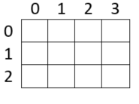
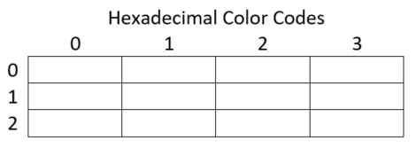
7.2. Create a Background Image Frame Row by Row
Create a simple background image.
To create an image we use 3x4 color image using the provided page. 3x4 is the size of the image. Why?
2. Take turns to find hexadecimal codes for each color.
Use RRGGBB for each hex code.
E.g., Red is FF0000.
3. In /home/pi/AOLME/Session7/, open and run
FrameEx.py. Modify the code for your example.
For the colors, modify code like:
r = “FF0000” # hex code for red
To create a red frame of size rows x cols, we use:
frame0 = np.array([[r]*cols for row in range (rows)])
Discuss this code. How does it work?
4. Enter the image row-by-row.
For example, for the 0th row for a four-column image, we use:
frame0[0] = [r, b, r, b] # Modify!
Discuss why each line has this format.
Discuss the difficulty in specifying images row-by-row.
Co-facilitator should relate discussions to the project. Make sure everyone participates.
AOLME PROJECT - LEVEL 1- SESSION 7- 2019
MATERIALS DEVELOPED BY THE AOLME PROJECT AT THE UNIVERSITY OF NEW MEXICO, PLEASE DO NOT COPY OR DISTRIBUTE ANY OF THESE COPYRIGHTED TASKS WITHOUT PROPER AUTHORIZATION

Slide 8
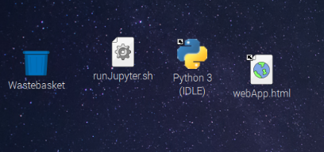
7.3. Make a Video Using A Sequence of Frames
Review the code order for making two 2x2 video frames:
Create the color variables
Create the video frame variable
Specify the frame row-by-row
Why should we define colors first?
Why create the video frame variable second?
2. Python IDLE. Open IDLE and navigate the
directory to /home/pi/AOLME/Session7/.
Run VideoEx1.py. Then modify the code to play
your two video frames.
Take turns modifying the frame_list variable:
frame_list = [frame0, frame1] # list of frames
How can you make a frame appear twice?
3. Replay: Modify the video to play slower and faster.
You will need to find and modify:
frame_list = [frame0, frame1] # list of frames
fps= 2 # frames per sec
play_video= vid_show(frame_list, fps)
# play on screen
Co-facilitators: Support the students with experimenting with the code.
4. Analyze: Study VideoEx1.py and find the parts of the code that perform the following:
Import libraries
Define colors
Define frames
Define the list of frames
Play the video
Take turns adding comments to the code to identify structure. Then discuss the structure of the code.
AOLME PROJECT - LEVEL 1- SESSION 7- 2019
MATERIALS DEVELOPED BY THE AOLME PROJECT AT THE UNIVERSITY OF NEW MEXICO, PLEASE DO NOT COPY OR DISTRIBUTE ANY OF THESE COPYRIGHTED TASKS WITHOUT PROPER AUTHORIZATION

Slide 9
7.4. Create a video character
Run /home/pi/AOLME/Session7/VideoEx2.py.
What is the image size? How do you know?
What is the background?
To avoid retyping the background code, we use: frame1 = frame0.copy()
How should we use copy() to create a character
moving against a background? Discuss.
Analyze: Study the code and change a pixel.
Note that the following code changes pixels:
frame1[0][2] = b # row=0, column=2
frame1[3][2] = b # row=3, column=3
What is the integer value for the first row?
What is the integer value for the last column?
Analyze: Open and run the file im_fill_Ex.py.
Change the color and location of the rectangle:
start_row = 1
end_row = 2
start_col = 0
end_col = 1
im_fill(frame1, [start_row, end_row], [start_col, end_col], v)
4. Discuss the following.
When will it be better to specify a character using:
Row-by-row?
Rectangles?
Pixels?
Co-facilitator should relate the discussions and questions to their own experiences and project.
AOLME PROJECT - LEVEL 1- SESSION 7- 2019
MATERIALS DEVELOPED BY THE AOLME PROJECT AT THE UNIVERSITY OF NEW MEXICO, PLEASE DO NOT COPY OR DISTRIBUTE ANY OF THESE COPYRIGHTED TASKS WITHOUT PROPER AUTHORIZATION

Slide 10
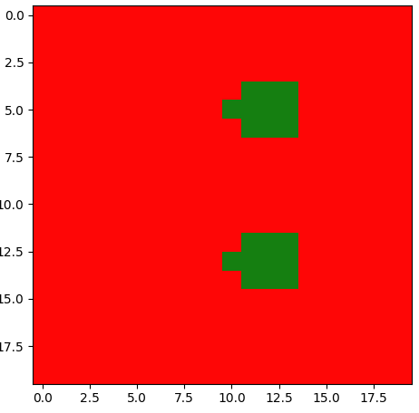
7.5. Move a Video Character
Open /home/pi/AOLME/Session7/VideoDemo.py
and run the code.
What is the background?
How many characters do you see?
How do the characters move?
Work through the code line-by-line and discuss:
How is the background defined?
How are the characters defined?
2. Analyze and modify: Find the following code and discuss what it does. How does it work?
move_r = 2
for row in range(rows):
for col in range(cols-move_r):
frame2[row][col+move_r]=frame1[row][col]
Go through the code and discuss the code that produces the other 3 movements.
3. Copy a portion of a frame: Find the following line of code, uncomment it, and run:
frame1[10:13,8:12] = frame1[2:5,8:12]
Note that rows 10, 11, and 12 and columns 8, 9, 10, 11
are copied.
Like for range(), you stop at row=13, column=12.
Thus, row=13 and column=12 are NOT copied.
4. Discuss the following:
What are the advantages of using the move code as opposed to defining the entire frame again?
Co-facilitator should lead the discussion back to the projects and coding movements. Students should pick their favorite characters and describe how they want them to move.
AOLME PROJECT - LEVEL 1- SESSION 7- 2019
MATERIALS DEVELOPED BY THE AOLME PROJECT AT THE UNIVERSITY OF NEW MEXICO, PLEASE DO NOT COPY OR DISTRIBUTE ANY OF THESE COPYRIGHTED TASKS WITHOUT PROPER AUTHORIZATION

Slide 11
Session 7. General Guidance for the Activity and Project
Resources for the Activity
Recommendations
Activity Card
Folder: /home/pi/AOLME/Session7/
and projects under this directory.
2. Raspberry Pi kit and laptop.
Make sure students ‘play’ with the code.
Make sure co-facilitator discusses their code.
Relate the activities to the co-facilitator project.
Let the students ask questions about the project that the co-facilitator worked on. Try not to tell them, instead ask questions to prompt their thinking.
Have students debrief and write about what they learned in session 7.
For the project, start the code using VideoDemo.py. It contains examples of code segments that you need to use.
Project Guidelines
Discuss project ideas in order to reach agreement.
What will the project be?
How will the work be distributed?
What are the colors?
What is the background?
What are the characters?
What are the movements?
Who will do what?
AOLME PROJECT - LEVEL 1- SESSION 7- 2019
MATERIALS DEVELOPED BY THE AOLME PROJECT AT THE UNIVERSITY OF NEW MEXICO, PLEASE DO NOT COPY OR DISTRIBUTE ANY OF THESE COPYRIGHTED TASKS WITHOUT PROPER AUTHORIZATION

